Slide 1
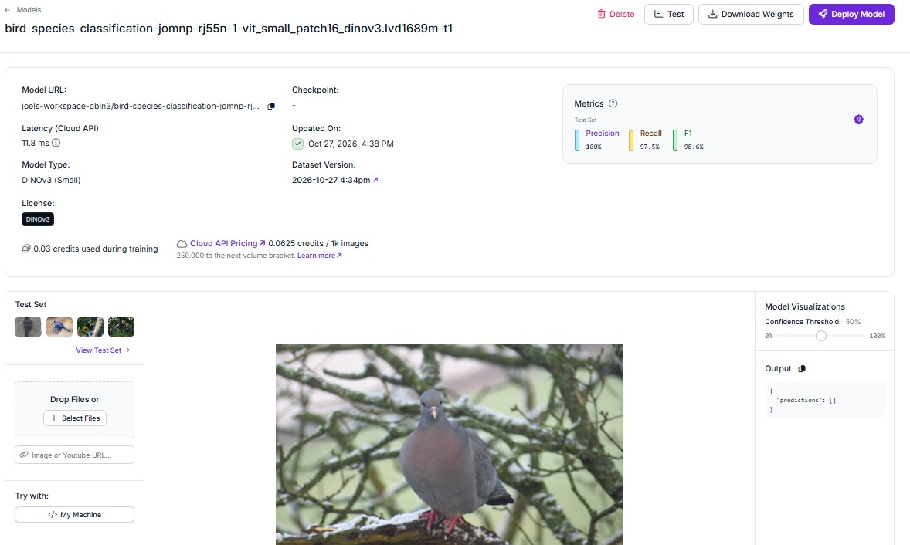
BIRDID / EYES ON EARTH
BIRDID
BirdID
The Hague
Bird Identifier
A photograph. A suggestion.
A starting point for learning.
Reference image from our Roboflow model screenshot
ROBOFLOW / DINOv3 SMALL
SDG 15 / LIFE ON LAND
01 / 10
Notes:
Suggested speaking time: 30 seconds.
“Our project is BirdID. We want to help students and beginner birdwatchers learn about birds from photographs. We trained a custom model in Roboflow. The intended application is a simple upload interface that gives a suggested category and confidence score. Today we will explain the model, demonstrate what actually works and discuss its limitations.”
Sources: supplied BirdID project summary; current local setup guide; presentation outline.
ZIP images: WhatsApp Image 2026-10-28 at 19.09.54.jpeg
Status: training is evidenced; no independent new-Dutch-photo test log or application source was supplied. Do not claim successful app testing until it has been performed.

Slide 2

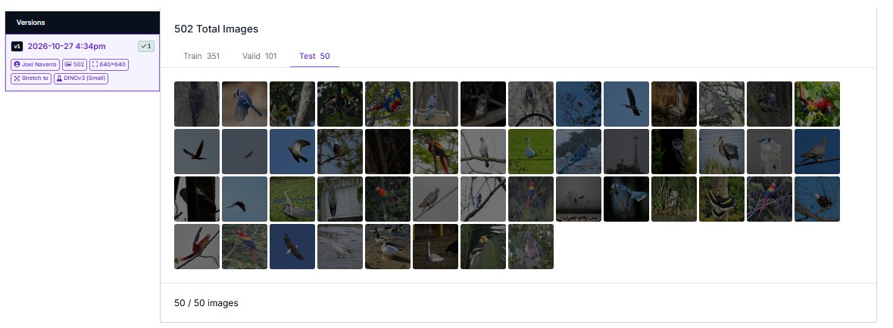

BIRDID / EYES ON EARTH
PROBLEM & PURPOSE
Help beginners start bird identification
A photo-first task
“Which bird is in this photograph?”
SDG 15: Life on Land
Notice. Identify. Learn.
HHS students new to bird identification.
Laptop + internet; a learning activity.
Species recognition supports learning.
Dutch species coverage is not validated.
SDG 15 / LIFE ON LAND
02 / 10
Notes:
Suggested speaking time: 40 seconds.
“We are keeping the product unchanged. Our selected users are HHS students who are new to bird identification, reviewing photographs during a biodiversity-learning activity. The task starts with an image rather than a species name. BirdID offers a tentative category so the learner has a starting point for checking a guide. Verification is outside the app; we are not claiming a verification feature or observation log. Vogelbescherming provides beginner bird-recognition courses and guides, which supports this learning context, but we have not interviewed HHS users or measured BirdID’s learning benefit. The SDG 15 contribution is supporting recognition of terrestrial biodiversity, not claiming that the classifier prevents extinction. The Hague describes the audience, not validated Dutch-species coverage.”
Sources: supplied BirdID project summary; current local setup guide; presentation outline.
ZIP images: WhatsApp Image 2026-10-28 at 19.09.54 (3).jpeg
Status: training is evidenced; no independent new-Dutch-photo test log or application source was supplied. Do not claim successful app testing until it has been performed.
Context: Vogelbescherming beginner recognition resources: https://www.vogelbescherming.nl/in-mijn-tuin/tuinvogels-herkennen
SDG 15: https://sdgs.un.org/goals/goal15
These sources support the topic, not BirdID effectiveness or HHS-specific need.

Slide 3
BIRDID / EYES ON EARTH
INTENDED LOCAL WORKFLOW
One photo in. One suggestion out.
INTENDED WORKFLOW
01
02
03
04
→
→
→
Upload photo
Run inference
Read the output
Verify the result
Local Streamlit app
Roboflow-hosted model
Category + model score
Check a guide outside the app
Local interface does not mean offline inference.
Internet access is required; uploaded images go to Roboflow. Keep the API key private.
SDG 15 / LIFE ON LAND
03 / 10
Notes:
Suggested speaking time: 35 seconds.
“The product is a Python/Streamlit photo classifier. Roboflow performs the necessary image-classification step; without that model, the upload interface cannot generate its intended suggestion. Its contribution is image-to-category inference, not simply storing images. The learner checks the result in a reliable guide outside the app. A score is not a guarantee, and an empty result is not an identification. The setup guide covers local execution, not cloud deployment. The diagram describes the workflow; a working end-to-end demonstration still needs verification.”
Sources: supplied BirdID project summary; current local setup guide; presentation outline.
Status: training is evidenced; no independent new-Dutch-photo test log or application source was supplied. Do not claim successful app testing until it has been performed.

Slide 4
BIRDID / EYES ON EARTH
DATASET & MODEL
502 labelled images. A local-data gap.
502
labelled images
DINOv3
Small
8 categories reported
351
training
101
validation
50
test
Reused Universe dataset;
not collected by our team.
SDG 15 / LIFE ON LAND
04 / 10
Notes:
Suggested speaking time: 50 seconds.
“We used an existing labelled dataset rather than collecting or scraping the photographs ourselves. The supplied dataset screenshot shows 502 images and this split. Our summary reports eight bird categories, while the class explorer also displays a placeholder label. We need to inspect the full taxonomy. The summary reports CC BY 4.0, but we still need the exact original dataset page and attribution. Reusing this dataset does not demonstrate compliance with the assignment’s self-collected or self-scraped Dutch-data requirement.”
Sources: supplied BirdID project summary; current local setup guide; presentation outline.
ZIP images: WhatsApp Image 2026-10-28 at 19.09.54 (3).jpeg
Status: training is evidenced; no independent new-Dutch-photo test log or application source was supplied. Do not claim successful app testing until it has been performed.

Slide 5
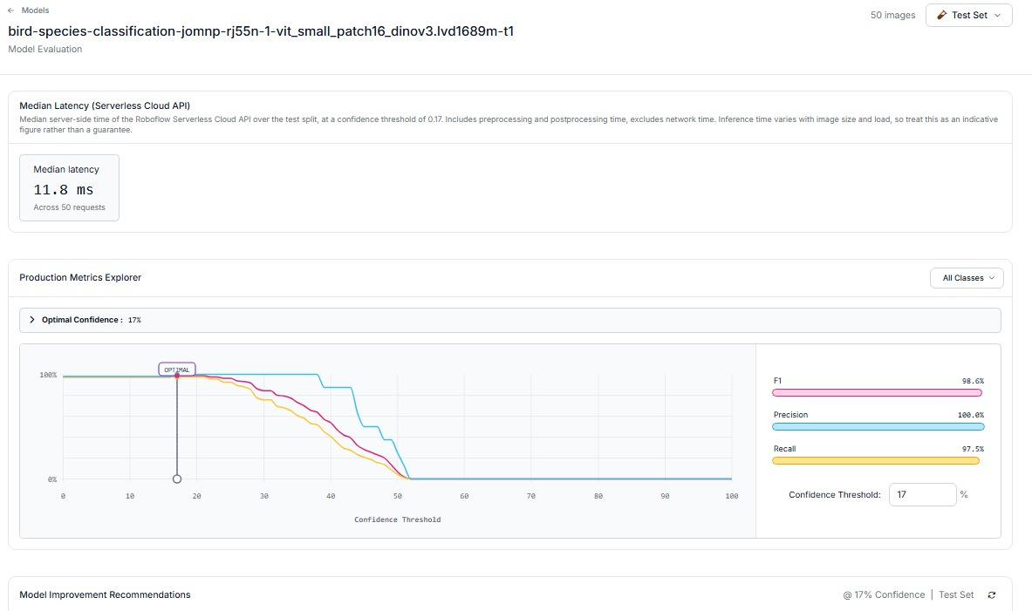
BIRDID / EYES ON EARTH
EVALUATION
Strong test scores are not field validation
100%
Precision
97.5%
Recall
98.6%
F1 score
11.8 ms
server-side
median latency
SDG 15 / LIFE ON LAND
05 / 10
Notes:
Suggested speaking time: 50 seconds.
“Roboflow displays high scores on its test split at a 17% threshold. We report those platform values as shown; we should not reinterpret F1 as a percentage of all future photos that will be correct. The latency is server-side, not the complete time from upload to a result. The test set is small and does not replace an independent evaluation on new Dutch photographs. Any threshold tuning should use validation data, not repeatedly optimise against the final test set.”
Sources: supplied BirdID project summary; current local setup guide; presentation outline.
ZIP images: WhatsApp Image 2026-10-28 at 19.09.54 (2).jpeg
Status: training is evidenced; no independent new-Dutch-photo test log or application source was supplied. Do not claim successful app testing until it has been performed.

Slide 6
BIRDID / EYES ON EARTH
LOCAL LIVE DEMO
Live demo: upload an unseen photograph
1
Start the local app
2
Upload a new bird photo
3
Show the output + score
4
Check the label independently
python -m streamlit run app.py
Reference: Roboflow model page, not a recorded app result
SDG 15 / LIFE ON LAND
06 / 10
Notes:
Suggested speaking time: 90 seconds.
“For this demonstration, the learner starts with a photograph rather than a species name. We show the model’s actual output, then check the candidate in a guide outside BirdID. That is the complete task we are proposing for beginners. Only describe the image as unseen and the label as independently verified if those conditions have been checked. A failed suggestion is useful evidence, not something to hide. The screenshot is a model-interface reference, not a recorded app result.”
Sources: supplied BirdID project summary; current local setup guide; presentation outline.
ZIP images: WhatsApp Image 2026-10-28 at 19.09.54.jpeg
Status: training is evidenced; no independent new-Dutch-photo test log or application source was supplied. Do not claim successful app testing until it has been performed.
Local setup and fallback: Demonstrate inference in Roboflow’s model test interface and explicitly state: “This demonstrates the trained model, not the local app.” A screenshot is a backup illustration, not a live demo, and does not fulfil the working-product requirement by itself. Do not claim successful unseen-image testing before recording an actual result. The supplied [demo link](https://youtu.be/2BRMlEG2k7c) is retained, but its contents were not independently verified for this revision.

Slide 7
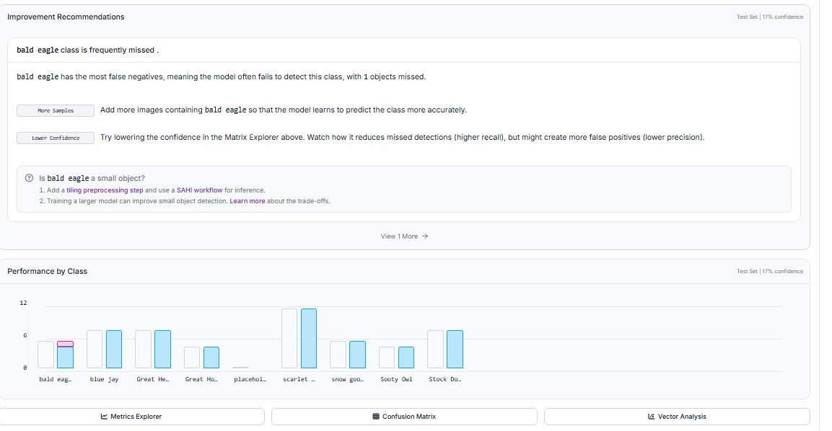
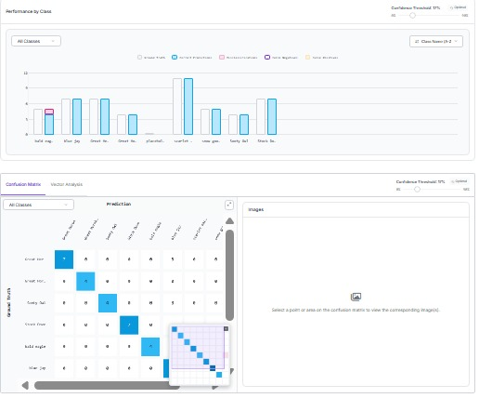
BIRDID / EYES ON EARTH
FAILURE MODES
Class-level errors still matter
1 bald-eagle example missed
At 17% confidence, on the test split.
Audit the category labels.
SDG 15 / LIFE ON LAND
07 / 10
Notes:
Suggested speaking time: 45 seconds.
“The supplied model screenshot contains an empty prediction at a 50% threshold. That is not a successful identification. The improvement panel also reports one missed bald-eagle example at 17%. These observations show why a single headline metric is not enough. We cannot infer that lowering the threshold always solves the problem, or that it guarantees correct predictions. The model also has a limited category set and has not been validated for local Dutch species.”
Sources: supplied BirdID project summary; current local setup guide; presentation outline.
ZIP images: WhatsApp Image 2026-10-28 at 19.09.54 (4).jpeg; WhatsApp Image 2026-10-28 at 19.09.54 (1).jpeg; WhatsApp Image 2026-10-28 at 19.09.54.jpeg
Status: training is evidenced; no independent new-Dutch-photo test log or application source was supplied. Do not claim successful app testing until it has been performed.

Slide 8



BIRDID / EYES ON EARTH
ETHICAL REFLECTION
Responsible AI starts with the data
Data honesty
Human oversight
Privacy & security
Imported images; Dutch provenance
and licence attribution need checking.
Suggestions are not wildlife records.
Do not automate conservation decisions.
Protect people, nest locations and keys.
Explain that images go to Roboflow.
The assignment’s original Dutch-data collection requirement is not yet demonstrated.
SDG 15 / LIFE ON LAND
08 / 10
Notes:
Suggested speaking time: 45 seconds.
“Our ethical reflection explains the dataset gap and the risks. A user might confidently record an incorrect species or miss a species outside the label set. BirdID should remain an educational aid, not a basis for conservation or animal-handling decisions. Users should avoid sharing identifiable people or sensitive nest locations. Before deployment, we must check the cloud provider’s data terms and avoid promising deletion or zero storage without evidence. The API key must stay outside the public repository.”
Sources: supplied BirdID project summary; current local setup guide; presentation outline.
Status: training is evidenced; no independent new-Dutch-photo test log or application source was supplied. Do not claim successful app testing until it has been performed.

Slide 9
BIRDID / EYES ON EARTH
LEARNING & NEXT STEPS
A starting point, not a verified identification
01
Start with a photograph
NEXT TO VERIFY
No species name is needed before the search.
Trained model
02
Get a tentative category
Complete
Qualifying Dutch dataset
Roboflow supplies the image-classification step.
Unresolved
03
Check with a guide
Local app demonstration
Not yet verified
Verification is outside the app; benefits are unmeasured.
New-photo evaluation
Not yet documented
SDG 15 / LIFE ON LAND
09 / 10
Notes:
Suggested speaking time: 40 seconds.
“The delivered scope stays bounded: upload, model inference and a category with a score. The proposed value is giving a beginner a candidate name to check, not replacing guides or collecting conservation records. A meaningful demonstration should follow that complete user task with a real unseen photo and an independently checked label. That could provide evidence of usefulness; documentation alone cannot establish it. We have not measured learning gains or shown that BirdID is better than existing tools. Training is evidenced, while the qualifying Dutch dataset, end-to-end local app demonstration and independent new-photo evaluation remain open. Resolve the assignment’s data requirement with the instructor or collect qualifying data; do not present that future work as complete.”
Sources: supplied BirdID project summary; current local setup guide; presentation outline.
Status: training is evidenced; no independent new-Dutch-photo test log or application source was supplied. Do not claim successful app testing until it has been performed.

Slide 10
BIRDID / EYES ON EARTH
QUESTIONS
What would you test
before trusting
BirdID?
A suggested label is not
a verified ecological fact.
Reference photo from the supplied Roboflow screenshot
Thank you. Questions?
SDG 15 / LIFE ON LAND
10 / 10
Notes:
Suggested speaking time: 25 seconds.
“Our aim is to make learning about birds more approachable. The important boundary is that a suggested label is not a verified ecological fact. Thank you—what would you want to test before trusting a tool like this?”
Sources: supplied BirdID project summary; current local setup guide; presentation outline.
ZIP images: WhatsApp Image 2026-10-28 at 19.09.54.jpeg
Status: training is evidenced; no independent new-Dutch-photo test log or application source was supplied. Do not claim successful app testing until it has been performed.

